Slide 1
POWERTRAIN

Slide 2
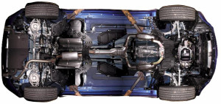
POWERTRAIN:
The powertrain encompasses every component that converts the engine’s power into movement.
This includes:
The engine
Transmission,
The driveshaft,
Differentials,
Axles
Basically anything from the engine through to the rotating wheels.
Image source: https://loubegacalledhewantshisfedoraback.files.wordpress.com/2011/10/350z_undercarriage_0011.jpg?w=300&h=142

Slide 3
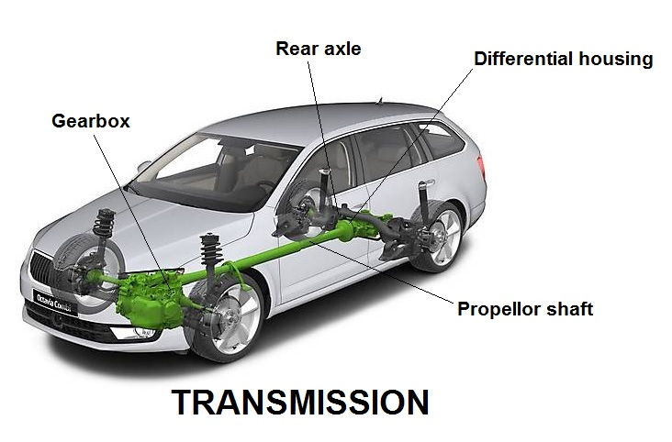
TRANSMISSION:
Its’ what that move engine power to the wheels.
Working of transmission is to enable the gear ratio between the drive wheels and engine to adjust as the car slows down and speeds up.
When a vehicle is stopped, the transmission disconnects the engine from the drive wheels.
image source: https://www.newkidscar.com/wp-content/uploads/2019/04/transmission.jpg

Slide 4
TYPE OF TRANSMISSION
1.Manual Transmission (MT)
Manual transmission, the driver selects all gears manually using both a movable gear selector and a driver-operated clutch.
also known as a “standard transmission” or a “stick shift”
image source: https://upload.wikimedia.org/wikipedia/commons/a/ac/Gearbox_4gears.gif

Slide 5
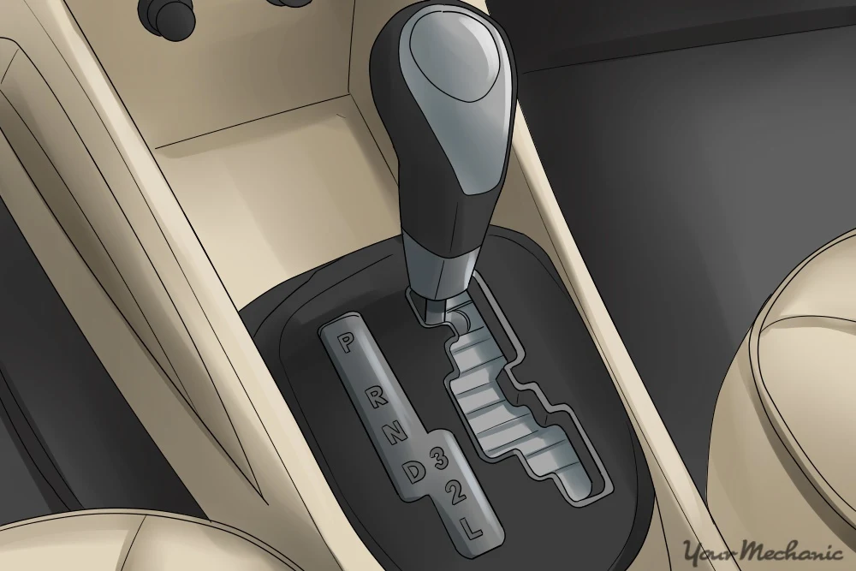
TYPE OF TRANSMISSION
2.Automatic Transmission (AT):
It uses a torque converter, planetary gearset and clutches or bands for gear shifting.
Automated Manual Transmission :
This transmission allows for either fully automatic forward gear shifts or manual shifts through the gear selector or through buttons or paddles on the steering wheel.
Image source: https://www.youtube.com/watch?v=u_y1S8C0Hmc

Slide 6
TYPE OF TRANSMISSION
3. Continuously Variable Transmission (CVT):
It uses belts, pulleys and sensors rather than gears to maintain a steady acceleration.
CVT can keep the engine in its optimum power range, thereby increasing efficiency and gas mileage.
image source: https://www.youtube.com/watch?v=PEq5_b4LWNY

Slide 7
Different Driving Mode:
source: https://www.drivparts.com/parts-matter/learning-center/driver-education-and-vehicle-safety/drivetrain-guide.html

Slide 8


Automotive Systems and Overview

Slide 9

Agenda
Session 1
Session 2
Session 3
Session 4
Session 5
Session 6
Summary

Slide 10
Type | Definition | Advantage | Disadvantage | Vehicles used in
DC series motor | It was the most widely used motor for traction application in the early 1900s. It contains brushes and commutators | DC motor delivers a good high accelerating during overload | Bulky structure High maintenance | Indian railways Tesla
Brushless DC motors | It is called brushless because it does not have the commutator and brush arrangement. The commutation is done electronically in this motor because of this BLDC motors are maintenance free. | Increased efficiency Reduced noise No sparking effect | Short constant power range | Electric vehicles Volta automotive Speego vehicles
Permanent magnet synchronous motor | This motor is also similar to BLDC motor which has permanent magnets on the rotor. The difference is that PMSM has sinusoidal back EMF whereas BLDC has trapezoidal back EMF. | Efficient High torque even at low speed | Cost is too high | Toyota Prius Ford focus electric BMW I3

